Slide 1
Getting Started ‘FIT_MPR’ {
forbeginners.html
workshop.css
[React Native]
< Presented by Group 1 >
}
#ReactJS, #JavaScript, #ReactNative

Slide 2
Table Of ‘Contents’ {
01
02
03
forbeginners.html
workshop.css
React Native Overview
< Learn to understand what is React Native and how it helps in building an app >
Project Setup
< Learn to get start with building an app using basic starting tools >
Practical Exercise
< Some practical exercises and QnA >
}
#ReactJS, #JavaScript, #ReactNative

Slide 3
01 {
[React Native Overview]
forbeginners.html
workshop.css
< Learn to understand what is React Native and how it helps in building an app >
}
#ReactJS, #JavaScript, #ReactNative

Slide 4
Getting Started; {
forbeginners.html
workshop.css
‘What do you need to prepare before going into the course?’
<p You should >
Have basic knowledge of JavaScript
Have some idea of React Apps
Be curious
Learn by coding
}
</p>
#ReactJS, #JavaScript, #ReactNative

Slide 5
What Is ‘React Native ?’ {
forbeginners.html
workshop.css
Fundamentals
< React Native runs on React >
< React is open source library for building user interfaces with JavaScript >
< Further reading on React > {
components
JSX
props
state
}
Read the docs:
https://react.dev/learn
https://reactnative.dev/docs/getting-started
Watch VOD resources
}
#ReactJS, #JavaScript, #ReactNative

Slide 6
What Is ‘React Native ?’ {
forbeginners.html
workshop.css
React.js | + | React Native | => | Real Native Mobile Apps
A Javascript library for building UI |  | A collection of Special React components |  | IOS
Typically used for web development |  | Components are compiled to native UI elements |  | Android
But it's actually react-dom that adds web support |  | Native platform APIs exposed to Javascript
React is platform-agnostic |  | React Native is like react-dom: It "connects" React to a special platform
}
#ReactJS, #JavaScript, #ReactNative

Slide 7
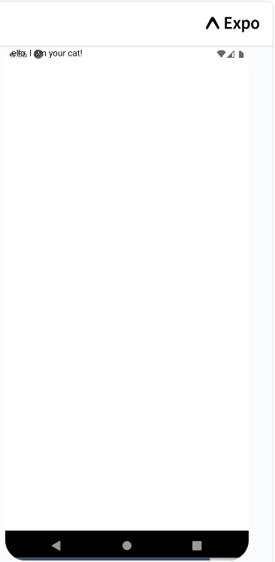
A look under the hood < /1 > {
forbeginners.html
workshop.css
import React from 'react';
import {Text} from 'react-native';
const Cat = () => {
return <Text>Hello, I am your cat!</Text>;
};
export default Cat;
only JSX and Components are compiled,
not Javascript logic
}
#ReactJS, #JavaScript, #ReactNative

Slide 8

A look under the hood < /2 > {
forbeginners.html
workshop.css
import React from 'react';
import { View, Text, StyleSheet } from 'react-native';
const Cat = () => {
const name = 'Maru';
return (
<View style={styles.container}>
<Text>Hello, I am {name}!</Text>
</View>
);
};
const styles = StyleSheet.create({
container: {
flex: 1,
justifyContent: 'center',
alignItems: 'center',
},
});
export default Cat;
}
#ReactJS, #JavaScript, #ReactNative

Slide 9
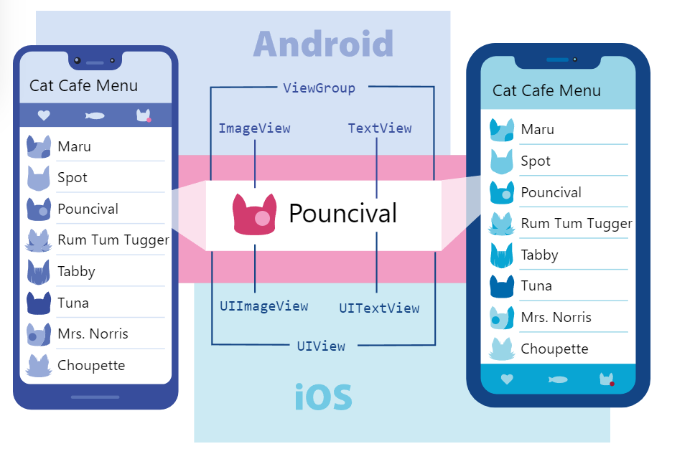
Core Components {
forbeginners.html
workshop.css
}
#ReactJS, #JavaScript, #ReactNative

Slide 10
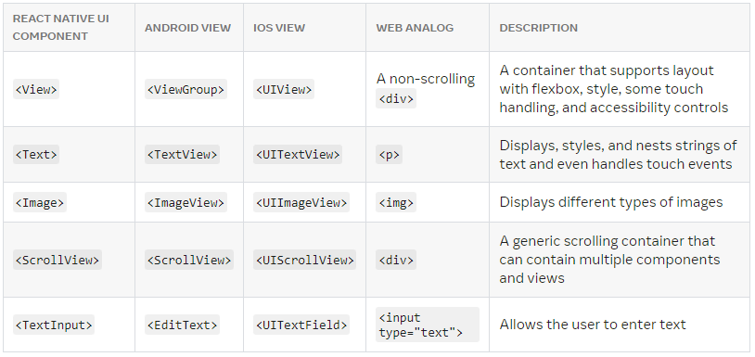
Core Components {
forbeginners.html
workshop.css
}
#ReactJS, #JavaScript, #ReactNative

Slide 11
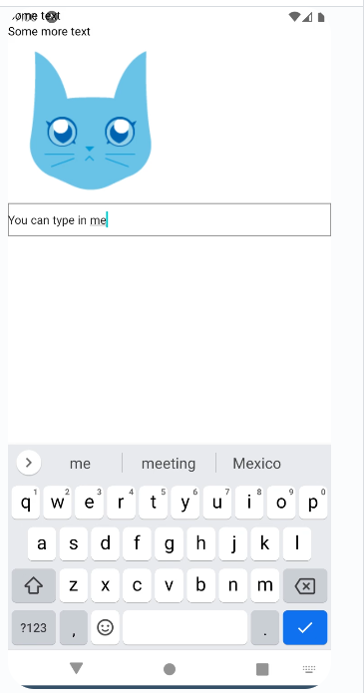
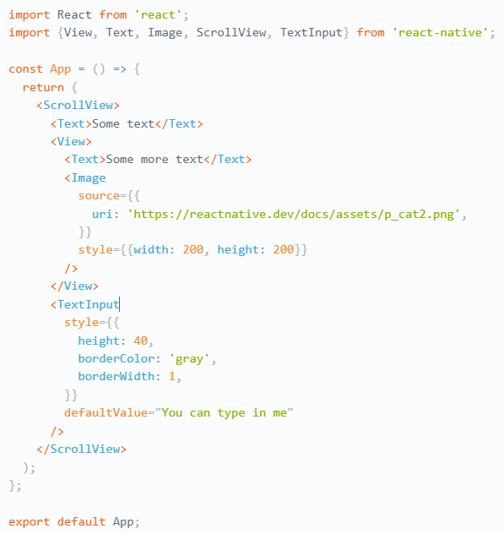
A look under the hood < /1 > {
forbeginners.html
workshop.css
import React from 'react';
import {View, Text, Image, ScrollView, TextInput} from 'react-native';
const App = () => {
return (
<ScrollView>
<Text>Some text</Text>
<View>
<Text>Some more text</Text>
<Image
source={{
uri: 'https://reactnative.dev/docs/assets/p_cat2.png',
}}
style={{width: 200, height: 200}}
/>
</View>
<TextInput
style={{
height: 40,
borderColor: 'gray',
borderWidth: 1,
}}
defaultValue="You can type in me"
/>
</ScrollView>
);
};
export default App;
}
#ReactJS, #JavaScript, #ReactNative

Slide 12
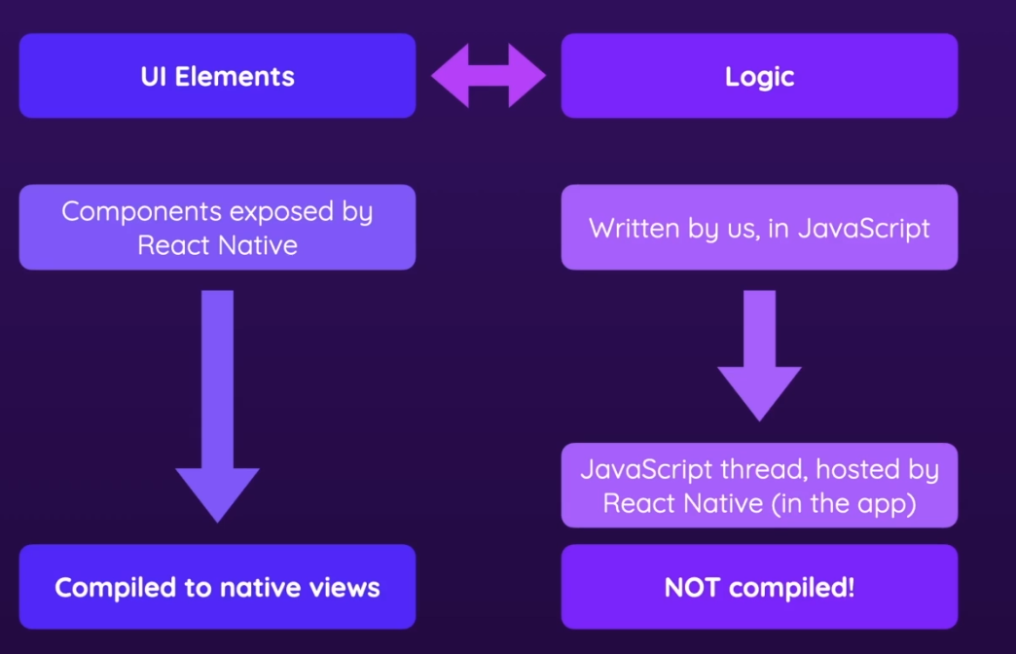
Introduction; {
forbeginners.html
workshop.css
}
#ReactJS, #JavaScript, #ReactNative

Slide 13
02 {
[Project Setup]
forbeginners.html
workshop.css
< Learn to get start with building an app using basic starting tools >
}
#ReactJS, #JavaScript, #ReactNative

Slide 14
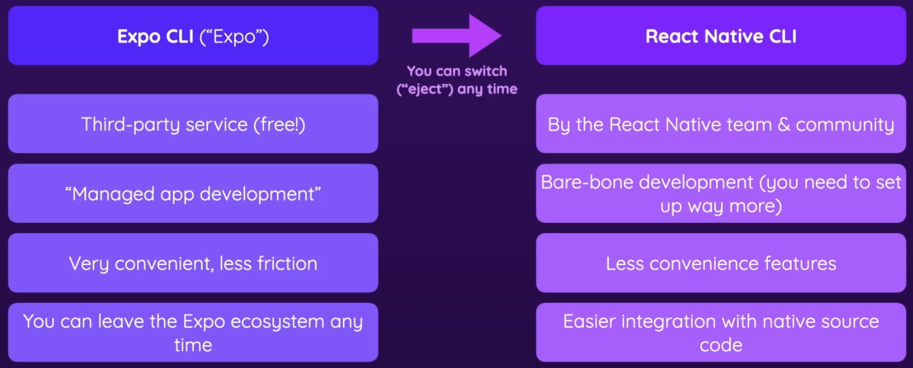
Creating React Native Projects< /1 > {
forbeginners.html
workshop.css
< Expo CLI vs React Native CLI >
}
#ReactJS, #JavaScript, #ReactNative

Slide 15
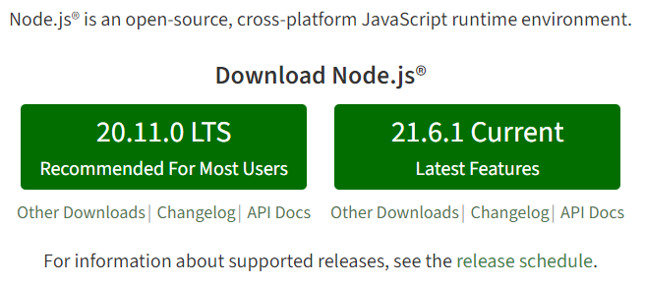
Creating React Native Projects< /2 > {
forbeginners.html
workshop.css
< Go to https://nodejs.org/en or click here to install node.js (npm) >
}
#ReactJS, #JavaScript, #ReactNative

Slide 16
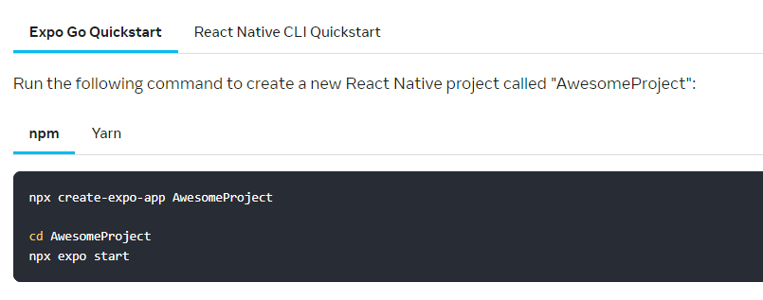
Creating React Native Projects< /2 > {
forbeginners.html
workshop.css
< Go to https://reactnative.dev/docs/environment-setup?guide=quickstart
or click here >
}
#ReactJS, #JavaScript, #ReactNative

Slide 17
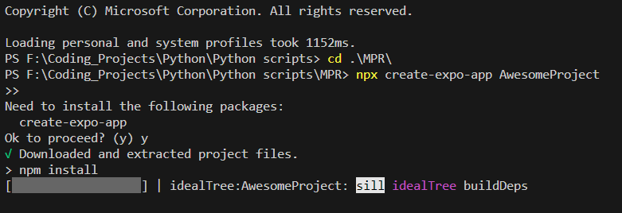
Creating React Native Projects< /2 > {
forbeginners.html
workshop.css
< Go to https://reactnative.dev/docs/environment-setup?guide=quickstart
or click here >
npx create-expo-app AwesomeProject
cd AwesomeProject
npx expo start
}
Note: npm install -g expo-cli
in case you have not install expo-cli
#ReactJS, #JavaScript, #ReactNative

Slide 18
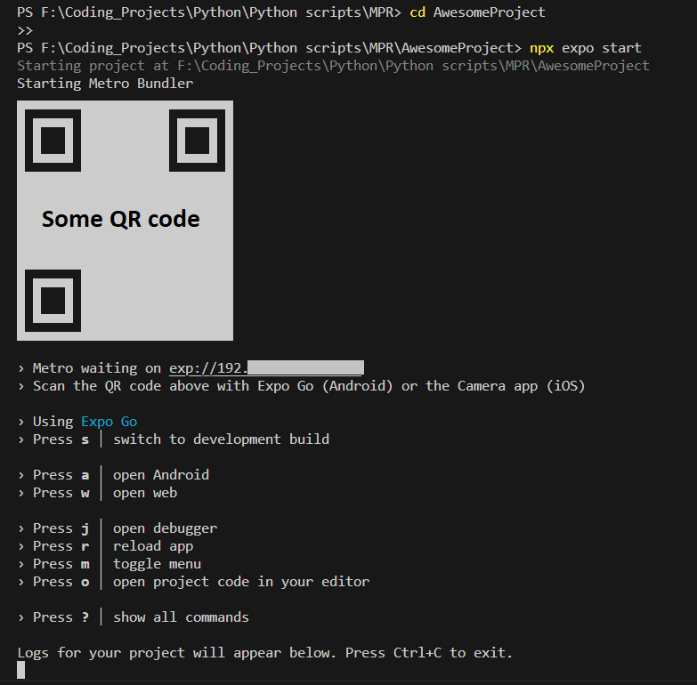
Creating React Native Projects< /2 > {
forbeginners.html
workshop.css
< After starting the server, the Server is hosted in the local machine, with a QR code generated to be scanned and accessed on Expo Go App (Android and IOS) >
< But before going deeper, let's analyze the code >
}
#ReactJS, #JavaScript, #ReactNative

Slide 19
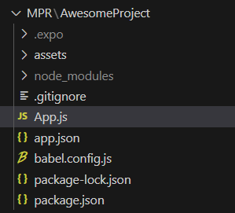
Creating React Native Projects< /3 > {
forbeginners.html
workshop.css
.gitignore:
.expo
.vscode
node_modules:
#Holds the 3rd party lib used
assets:
#Holds the assets and resources
pakage.json:
#Declare dependencies and others
app.json:
#expo related for display
App.js:
#The actual code
}
#ReactJS, #JavaScript, #ReactNative

Slide 20
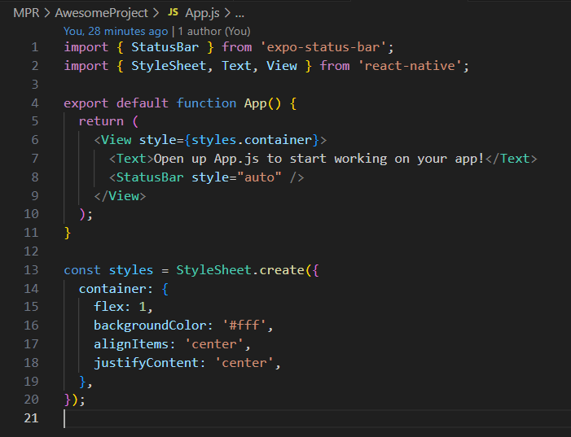
Creating React Native Projects< /3 > {
forbeginners.html
workshop.css
}
#ReactJS, #JavaScript, #ReactNative

Slide 21
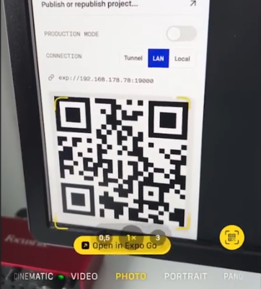
Android < /2 > {
forbeginners.html
workshop.css
< On Android, you can scan the QR code directly, or type in the URL >
}
IOS < /2 > {
< On IOS, you can scan the QR code using the camera and access the Expo App from there >
Scanning QR code using IOS camera
}
#ReactJS, #JavaScript, #ReactNative

Slide 22

Result{
forbeginners.html
workshop.css
}
#ReactJS, #JavaScript, #ReactNative

Slide 23
What if you don't have ‘a real device?’ {
forbeginners.html
workshop.css
Step 01
Install a Emulator:
Download Android Studio or Xcode (only available for IOS) for IOS emulator
Step 02
Set up your Emulator (Android/IOS)
Step 03
Start your project
Step 04
Select IOS or Android in Expo CLI
}
#ReactJS, #JavaScript, #ReactNative

Slide 24
03 {
[Practical Exercise]
forbeginners.html
workshop.css
< Some practical exercises and QnA >
}
#ReactJS, #JavaScript, #ReactNative

Slide 25
Practical Exercise {
< /1 >
< /2 >
forbeginners.html
workshop.css
< Create your first project and test out the App.js >
Successfully install expo CLI, create a new project
Start the project
Access the App from your phone
Modify the App
}
#ReactJS, #JavaScript, #ReactNative

Slide 26

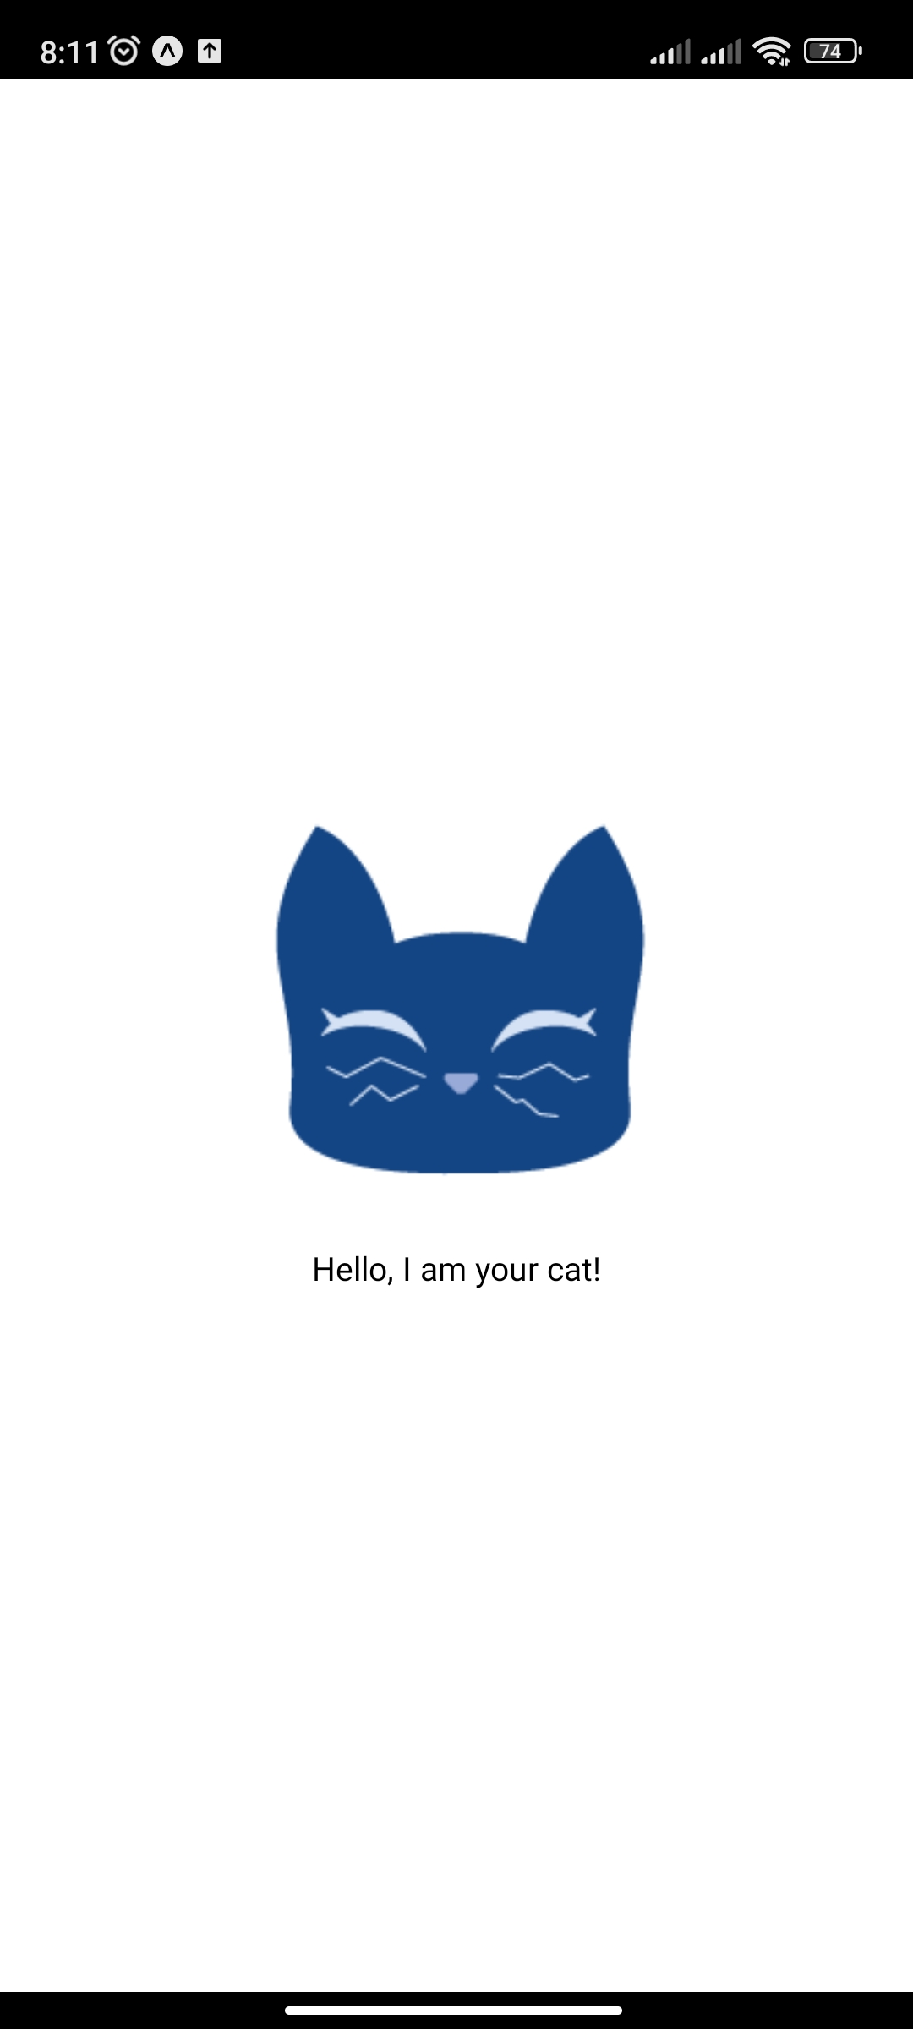
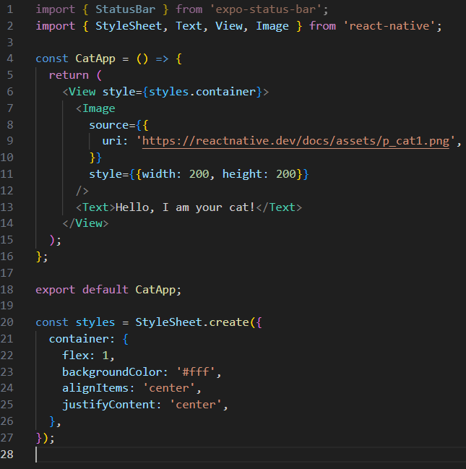
Practical Exercise {
forbeginners.html
workshop.css
import { StatusBar } from 'expo-status-bar';
import { StyleSheet, Text, View, Image } from 'react-native';
const CatApp = () => {
return (
<View style={styles.container}>
<Image
source={{
uri: 'https://reactnative.dev/docs/assets/p_cat1.png',
}}
style={{width: 200, height: 200}}
/>
<Text>Hello, I am your cat!</Text>
</View>
);
};
export default CatApp;
const styles = StyleSheet.create({
container: {
flex: 1,
backgroundColor: '#fff',
alignItems: 'center',
justifyContent: 'center',
},
});
}
#ReactJS, #JavaScript, #ReactNative

Slide 27
Thanks; {
forbeginners.html
workshop.css
‘Do you have any questions?’
1801040020@s.hanu.edu.vn
1801040027@s.hanu.edu.vn
1801040036@s.hanu.edu.vn
1801040218@s.hanu.edu.vn
1901040011@s.hanu.edu.vn
}
#ReactJS, #JavaScript, #ReactNative

